Slide 1
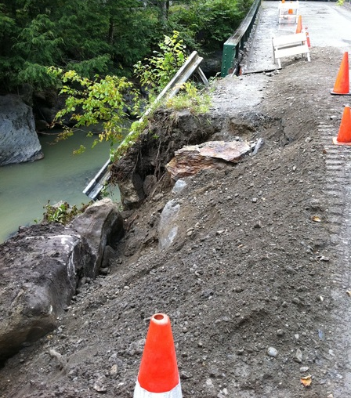
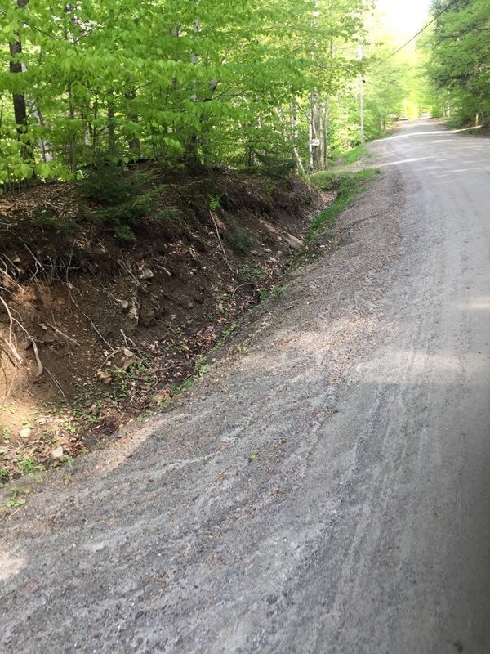
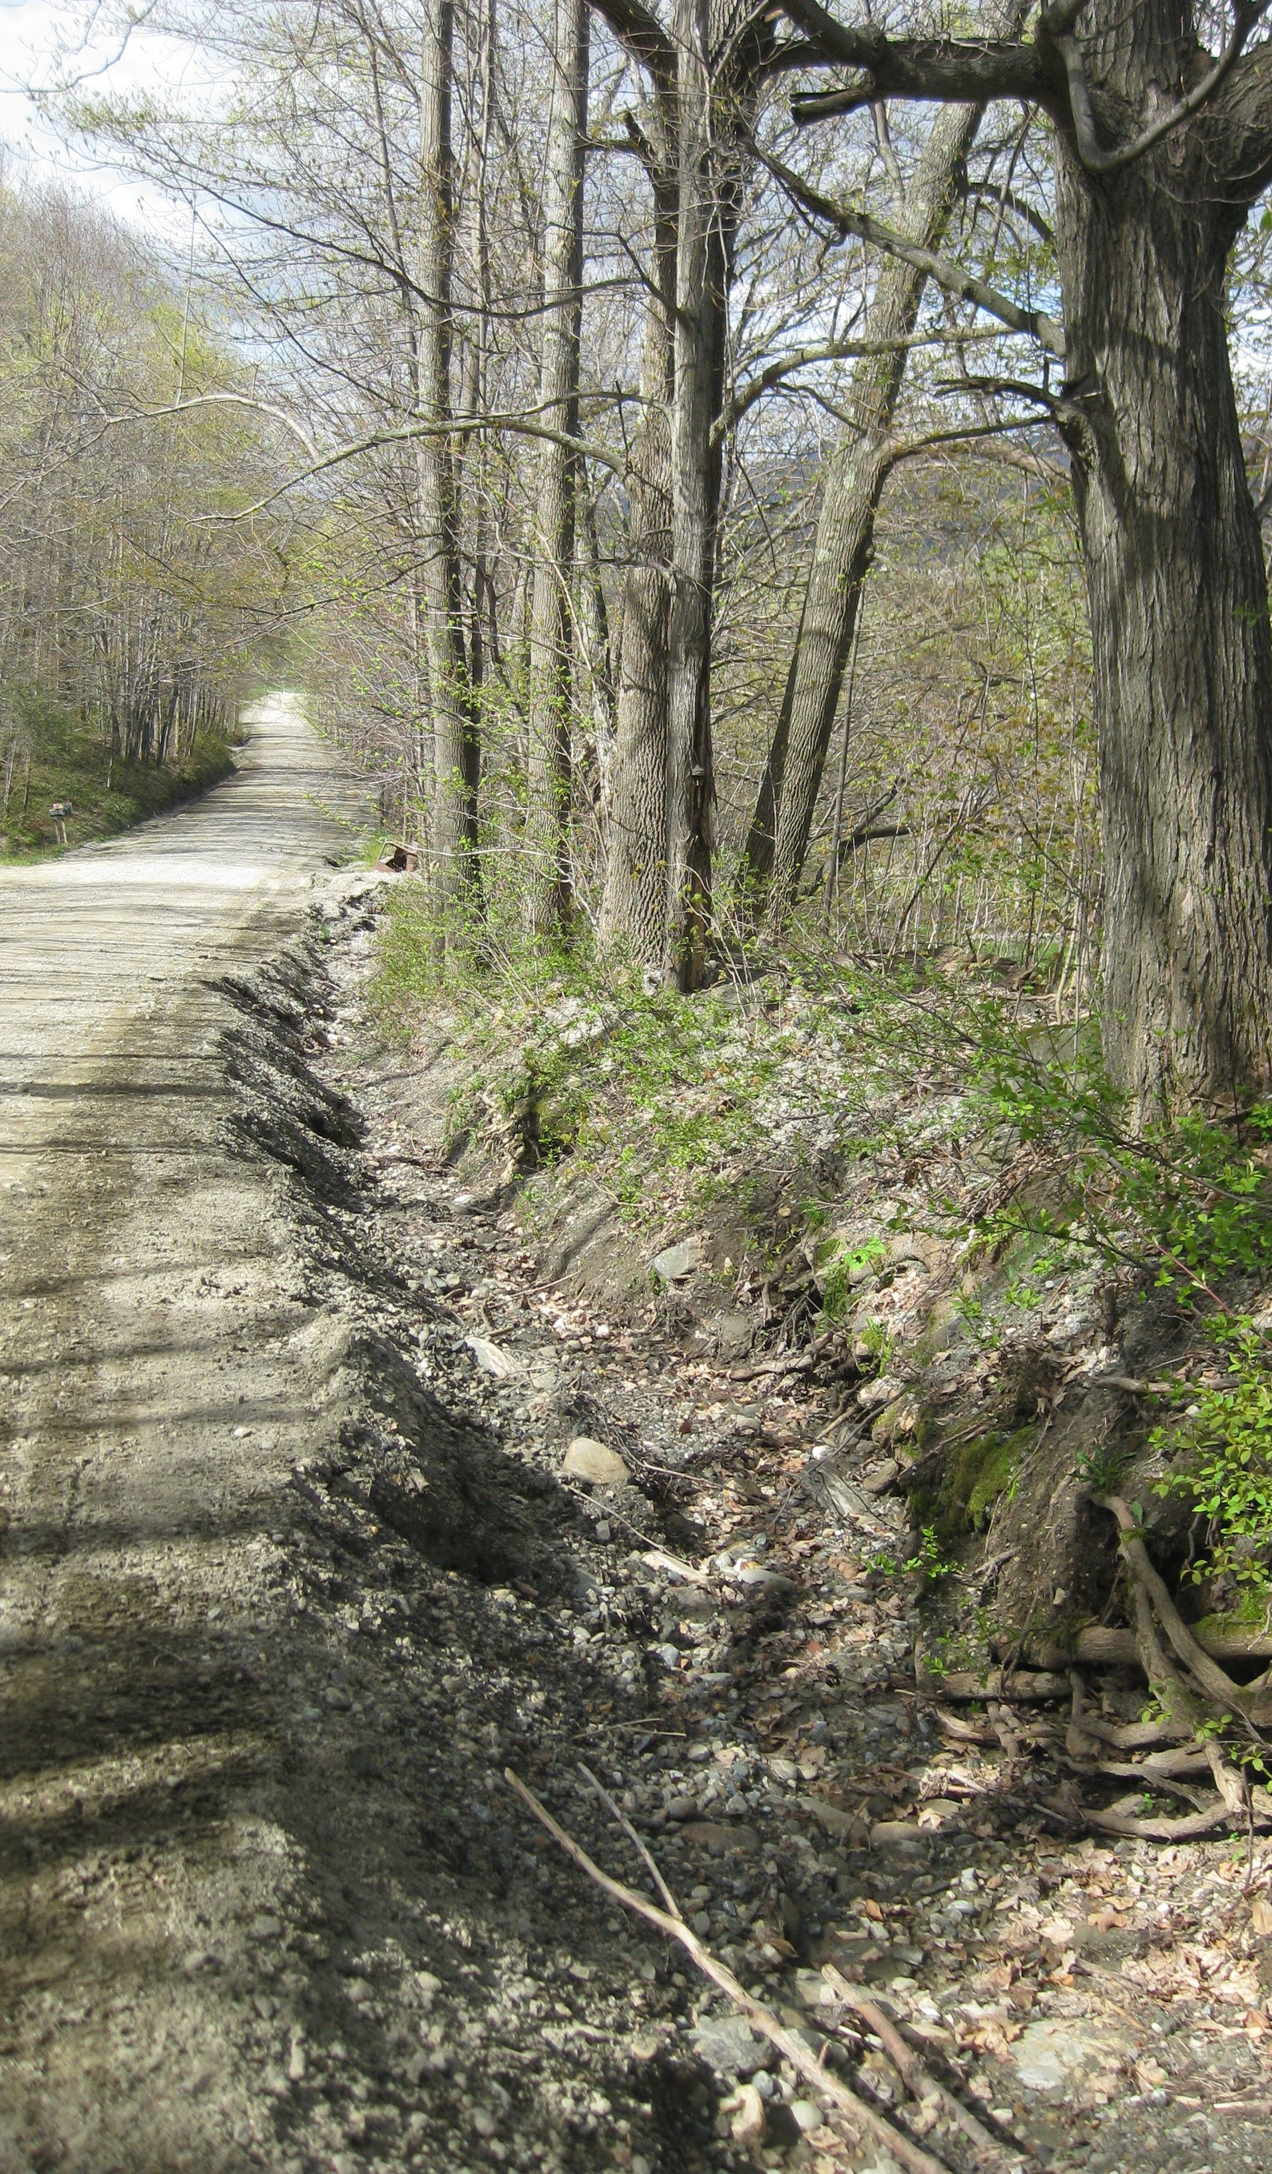

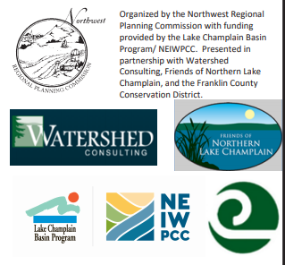
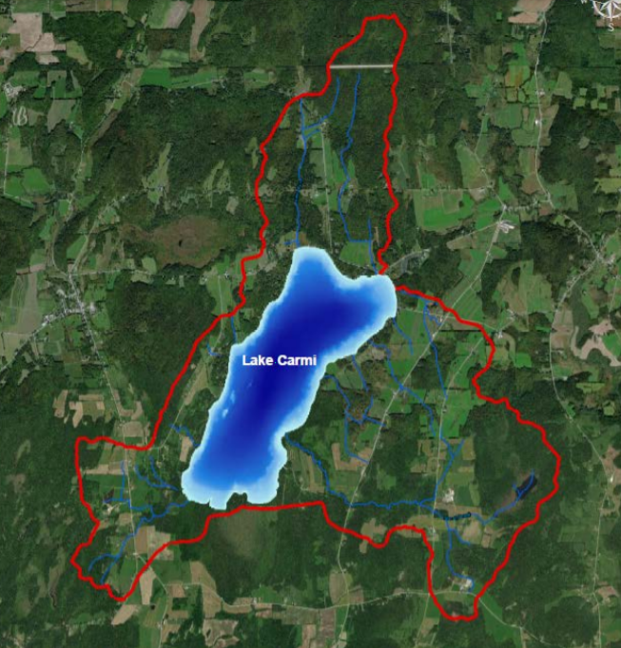
Lake Carmi Watershed
Private Roads and Driveways
Best Management Practices Webinar
https://dec.vermont.gov/sites/dec/files/wsm/lakes/docs/2018_08_22_Lake_Carmi_Crisis_Response_Plan_2.0.pdf
Date: Wednesday July 14th, 2021
Time: 6:30 – 7:30 PM
Location: Live Online Webinar via Zoom

Slide 2
Why are we here?
Share a set of tools to help you better understand the connection to stormwater on your property
and take action
Build base knowledge on drainage and driveways
Learn simple, low-cost stormwater solutions
See examples of practices in action
Review resource packet
Notes:
What you hope to learn from this workshop? Show of hands…

Slide 3
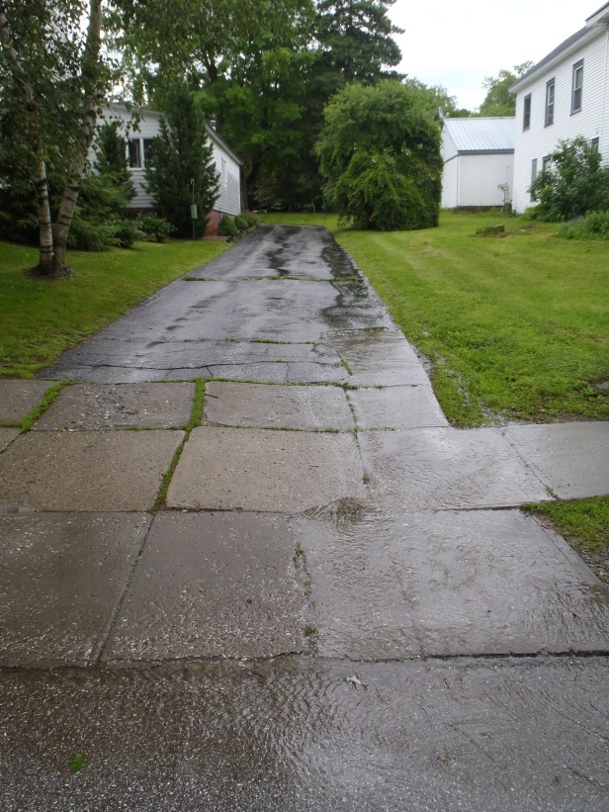
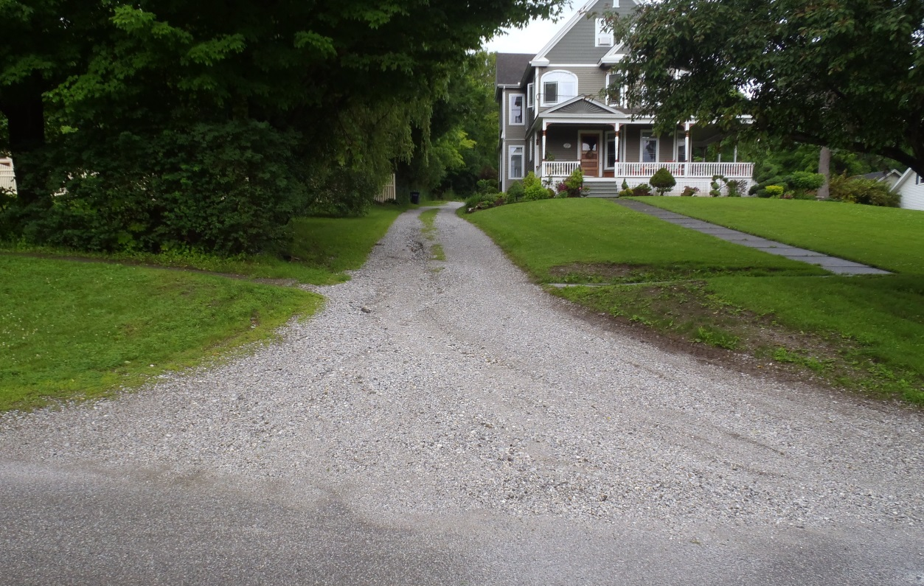
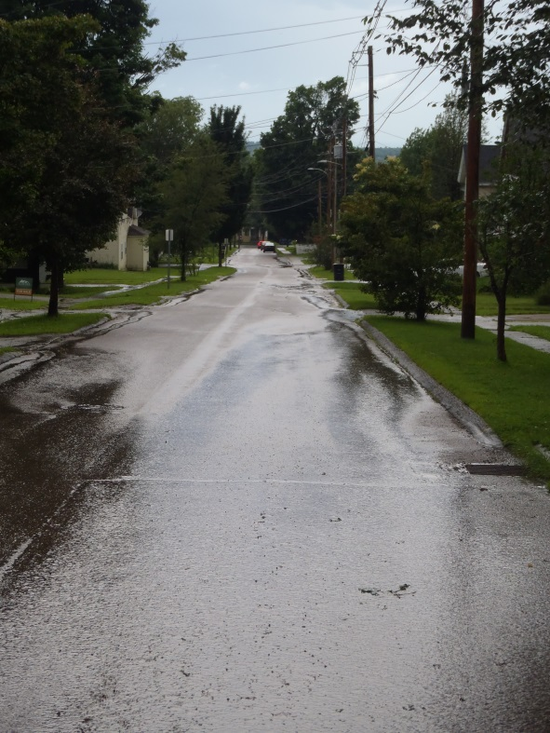
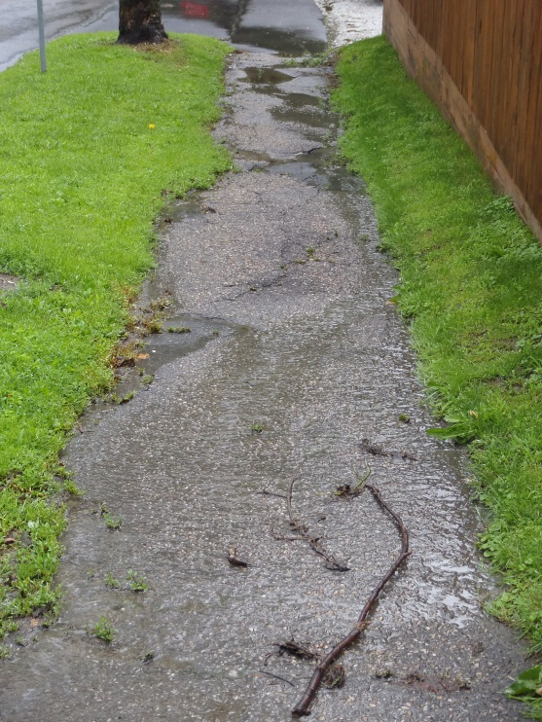
What is Stormwater runoff?
Precipitation from rain or snowmelt that is not absorbed into the ground and flows over the landscape
When rain hits impervious surfaces like driveways, sidewalks, and buildings it cannot soak into the ground
and becomes runoff
Gravel too!!
Photos by A. Holland
Notes:
For those who think this does not apply…well we are including gravel roads and driveways too. Given the level of compaction that happens during construction.

Slide 4
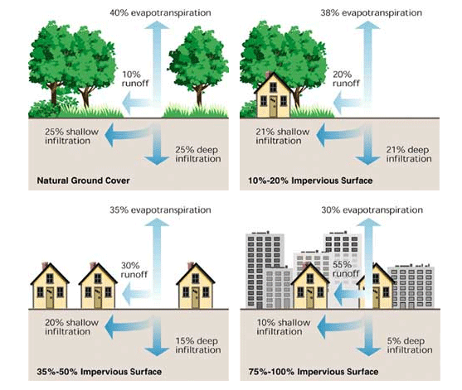
Changes to Water Cycle
Notes:
It is important to understand how development changes the natural water cycle
Review “Natural” and “Dense City System” -- These represent the two extremes.
But you’ll see even a little bit of impervious surface, say one house and a driveway starts to change how the water cycle functions.

Slide 5
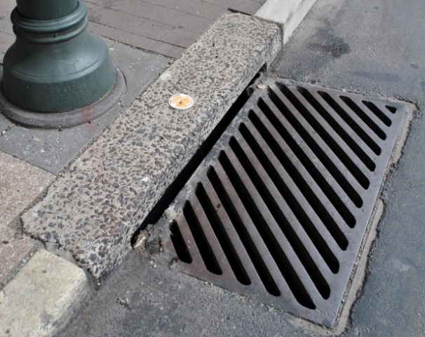
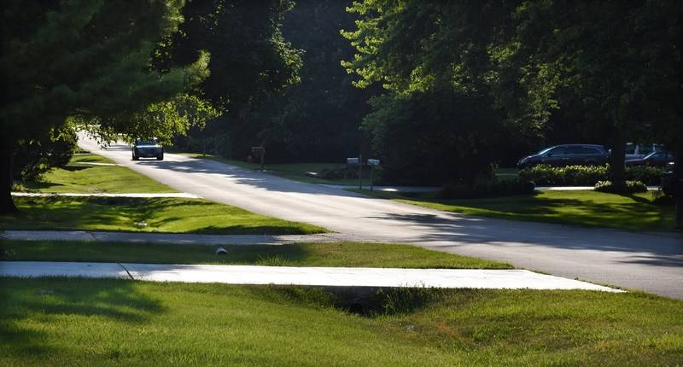
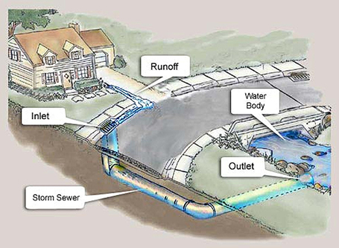
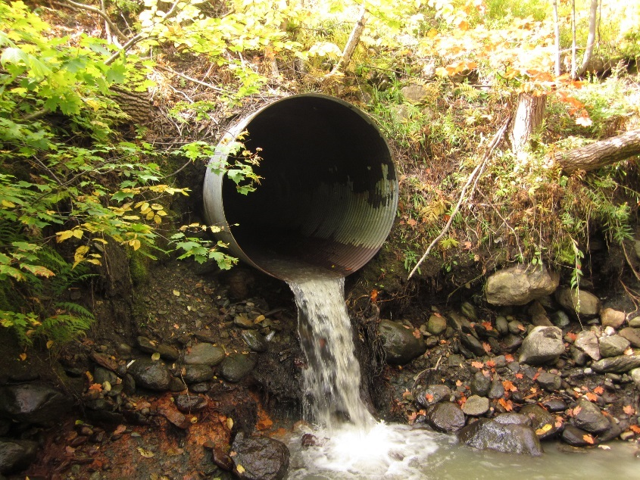
The Path of Stormwater
Storm drain network
Town ditch (& culvert) network
Notes:
Once stormwater leaves your property it has two common fates –
If you are in a village or city center it most commonly runs to the storm drain system
If you live outside the village or city, it runs into the town ditch system
---in both of these scenarios this water will end up in our streams and Lake Champlain

Slide 6
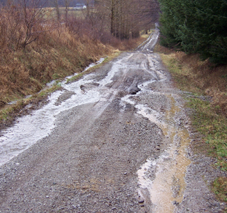
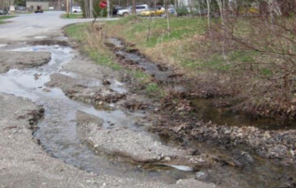
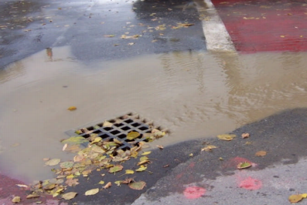
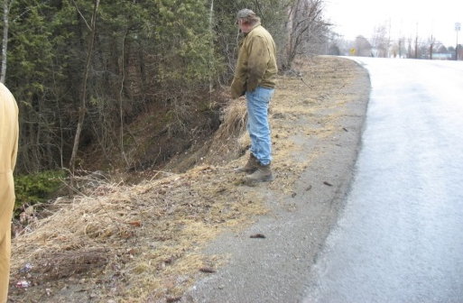
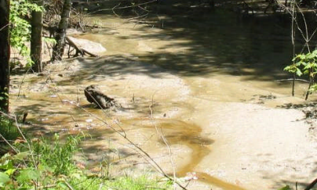
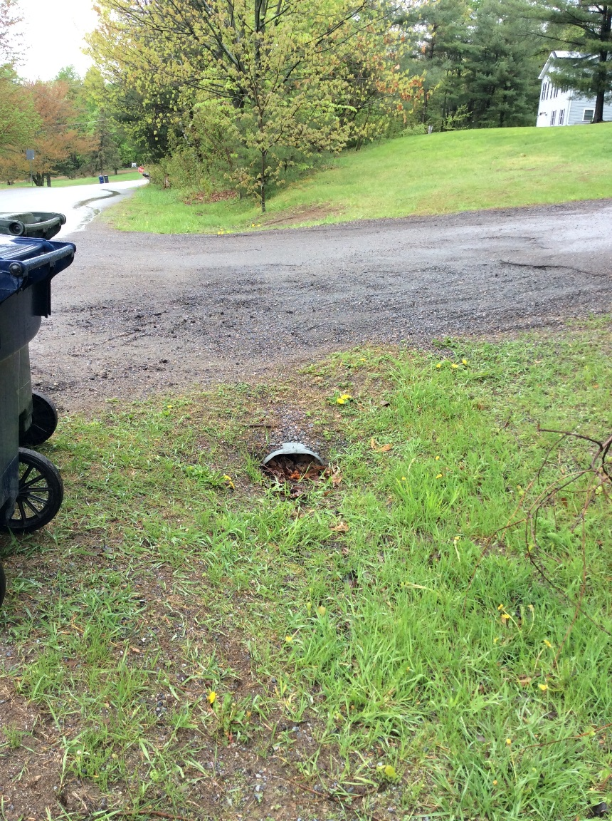
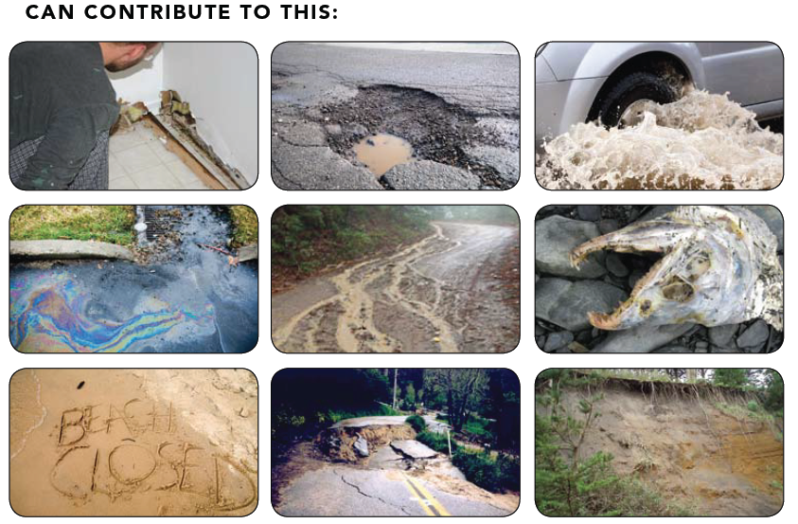
Why is Stormwater A Problem?
Changes in hydrology
  Increased flooding
  Stream bank erosion
  Lower groundwater infiltration
Sediment Transport
  Stress on overall aquatic ecosystem
Nutrient Overload
  Increase algae blooms
  Economic & Recreational Nuisance
Bacteria Transport
  Excess nutrients in waterbody
Damages infrastructure
Pollutants
Notes:
POLLUTANTS
Why is stormwater runoff a problem? –
Examples of problems associated with stormwater - Stormwater can pick up debris, chemicals, dirt, and other pollutants. Anything that enters a storm drain system or ditch system is discharged and untreated into the waterbodies we use for swimming, fishing, and providing drinking water.
LEADS TO A LOT OF OTHER ISSUES
Changes in Hydrology: Stormwater runoff is more concentrated in developed lands (i.e. shopping center or educational facilities) than undeveloped land (i.e. forest or meadow). Too much stormwater runoff becomes a problem when streams have to accommodate more water, which can cause flooding, stream bank erosion, and overall stream instability.
Sediment Transport: Can lead to sediment transported into lakes and ponds from streams with unstable banks, dirt driveways, or construction sites. This increased sediment becomes a stress on aquatic ecosystem – decrease visibility, destroys fish habitat, allows invasive plants to grow more rapidly from higher levels of nutrients (in sediment)
Nutrient Overload: nutrients from eroding soils, fertilizers, septic systems, and even pet waste. Excess nutrients in water bodies speed up plant and algae growth, including cyanobacteria, which can be harmful to humans and animals. Plants and algae blooms can be a nuisance for swimming and boating, and it can also decrease the amount of oxygen in the water. This means that less oxygen is available for fish and other organisms to survive.
Bacteria Transport: Bacteria and nutrients from livestock, pet wastes, and faulty septic systems.
Infrastructure
Pollutants: Fertilizers, herbicides, and insecticides from agricultural lands and residential areas; Oil, grease, and toxic chemicals from urban areas

Slide 7
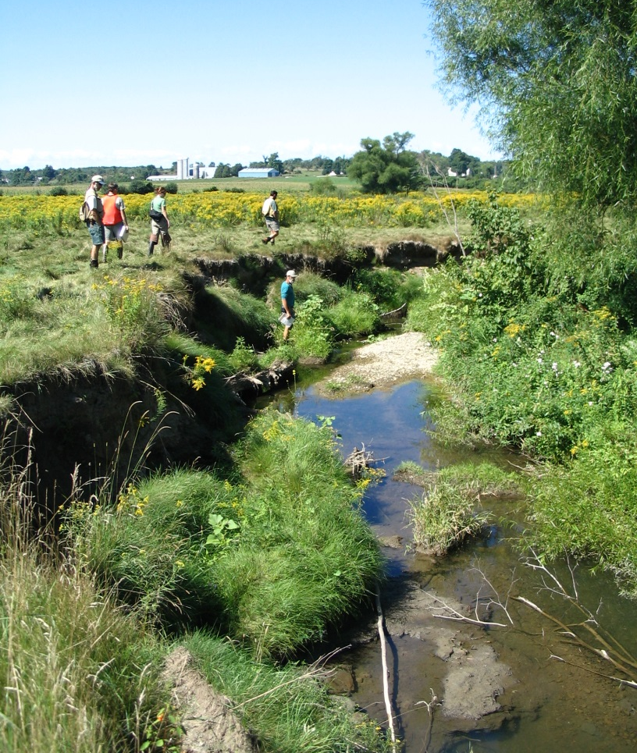
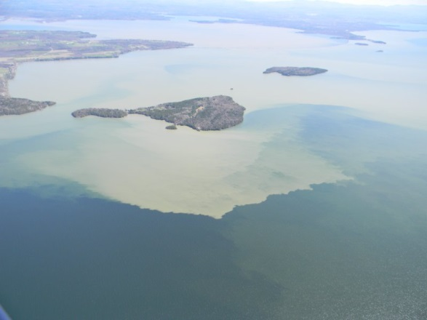
The Stormwater & Phosphorus Connection
Stormwater can increase erosion in the stream channel
Our soils contain high levels of phosphorus
Sediment is carried to the lake
Rugg Brook below the Industrial Park before restoration
Notes:
QUANTITY - Aside from the pollutants runoff can carry - it also causes damage.
Pollution from stormwater runoff and soil erosion is one of the most significant problems contributing to the decline in water quality in many lakes, rivers, and streams.
Approximately 22% of the phosphorus load to the Lake comes from developed lands in the watershed and 18% from streambank erosion.

Slide 8

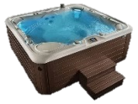


How much runoff are we talking?
Estimate the volume of stormwater generated from a 1” rainstorm
Stormwater volume (gallons) = (Total Impervious Area ft²) x 0.0833 x 7.488
0.0833 feet in one inch and 7.48 gallons are in a cubic foot
Driveway Lengths (assuming 12ft width) | Driveway Area | Gallons of Runoff | This fills…
Median - 148 ft | 1,776 sq ft | 1,108 gall
Average – 284 ft | 3,408 sq ft | 2,126 gall
26% of driveways between 300-499 ft (average 385 ft) | 4,620 sq ft | 2,882 gall
2.8
5.3
7.2
Notes:
NEW
30ft diameter x 4.5ft tall pool = ~23,800 gallons
Gallons of runoff / 23,800 gallons = # of pools
Gallons of runoff / 400 gallons = # of hot tubs
Median- 2.77
Average- 5.315
26% of driveways- 7.205

Slide 9
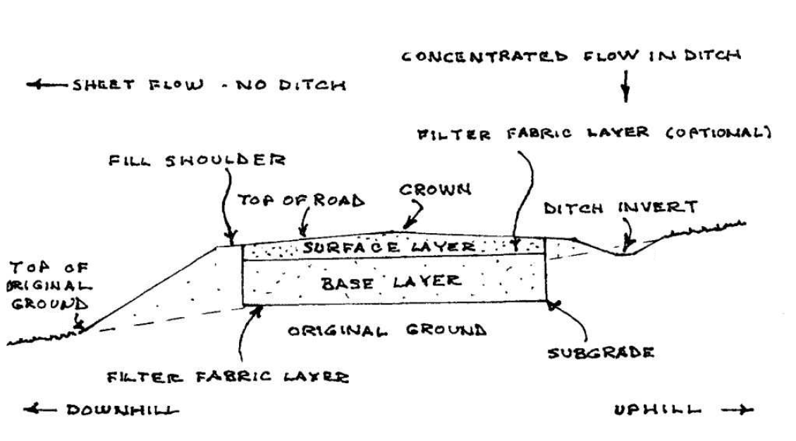
General Anatomy of a Road
Notes:
[Sources: VT Local Roads Factsheet – Basics of a Good Road 2009; VT Better Back Roads Manual 2009]
For both paved and gravel roads/driveways the top layer is shaped, compacted, and smoothed so that surface water runoff will move quickly from the road surface into established ditches
- A surface drainage system has four components: road crown, shoulders, ditches and culverts.
Crown – moves water to the edge of the road
Shoulders – help carry water to the ditches
Culverts – direct water away from road at various points
Importance to Maintenance & Water Quality:
Failure to direct surface water from the road surface to a drainage channel can result in deterioration of the road surface, safety problems (ice) and assorted erosion problems. Immediate removal of runoff from the road surface will:
Prevent erosion and road surface deterioration
Lessen the frequency and cost of maintenance, thereby lengthening the life of the road surface
Decrease the amount of sediment carried into surface waters.

Slide 10
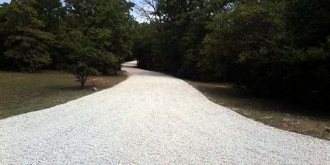
Characteristics of a “good” driveway
Sheds water
  Get water off as quickly as possible
Built on a firm foundation
  A road base determines the service life of a road
  Roads wear out on the top, but fall apart from the bottom
Material that packs
  Well-graded and jagged aggregates pack the best
Stabilize and revegetate disturbed areas
Maintenance
  Protect your Investment!
Key for Water Quality
Divert as much runoff as possible away from surface waters into vegetated areas
Notes:
https://t2.unh.edu/sites/t2.unh.edu/files/documents/publications/basics_of_good_road_0.pdf

Slide 11
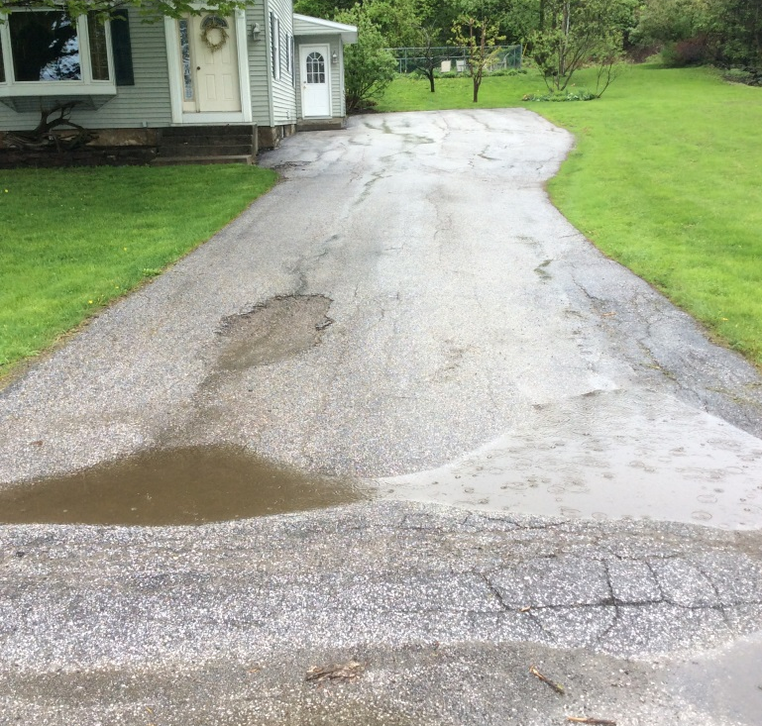
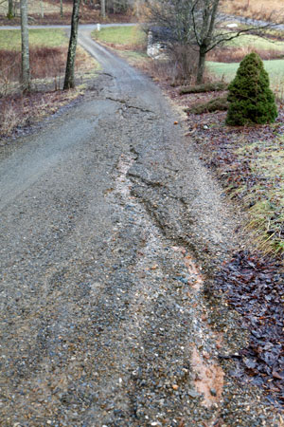
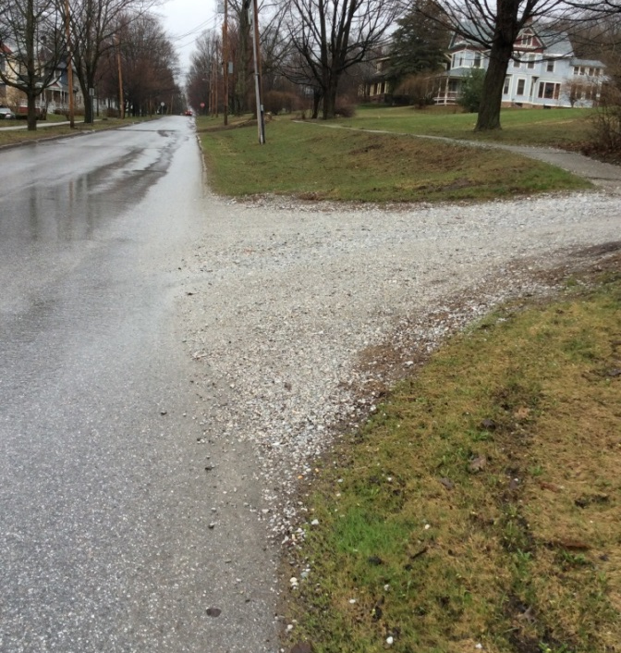
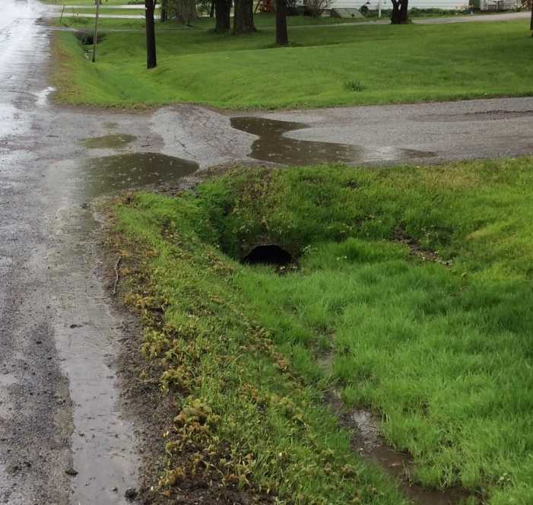
What does a stormwater (drainage) issue look like?
Avoid having water run lengthwise down the road
Notes:
Westmoreland Conservation District http://wcdpa.com/tech-services/dirt-gravel-low-volume-roads/driveway-washout
water runs down the driving surface, carrying off gravel and soil and scouring ruts.

Slide 12
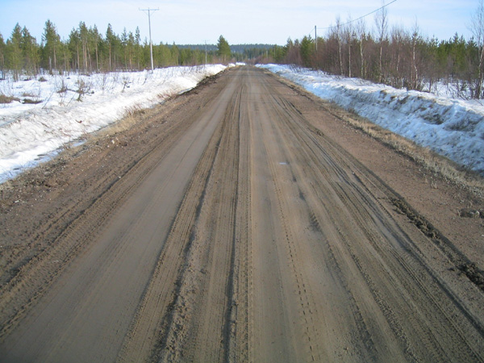
Rutting
longitudinal depressions in the wheel paths
Possible causes:
High moisture in subsurface soil
Inadequate thickness of surface layer
Heavy traffic loads
Notes:
Picture source: 1 http://www.roadex.org/e-learning/lessons/permanent-deformation/permanent-deformation-rutting-classification/
Notes:
-primary issue probably is…
-when there is frost penetration in the winter, frost and moisture cause small expansion of the materials in the road/driveway surface
-also expands frost susceptible soils in the subgrade
-during the thawing period, aggregate layers and subsoil layers de-compact, which causes the rutting
Picture source: 2 https://www.landscapediscount.com/gravel-grid-s/1932.htm
INFO from VT Better Backroads Manual

Slide 13
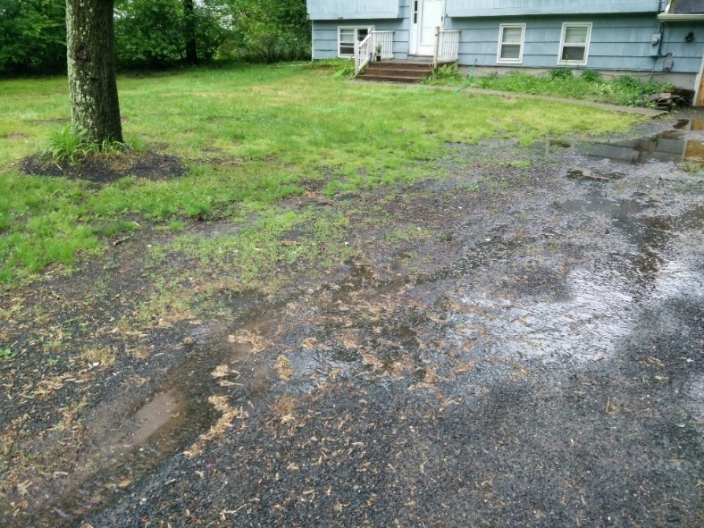
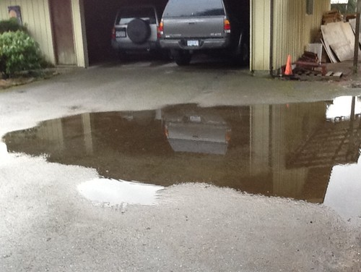
Depressions
Localized low areas (1in+) below the surrounding surface
Possible causes:
Settlement
Excessive moisture content
Improper drainage (shaping) to shed water
Will cause deterioration of pavement
Notes:
Picture source: https://diy.stackexchange.com/questions/67082/how-do-i-prevent-water-from-streaming-into-my-driveway
INFO from VT Better Backroads Manual

Slide 14
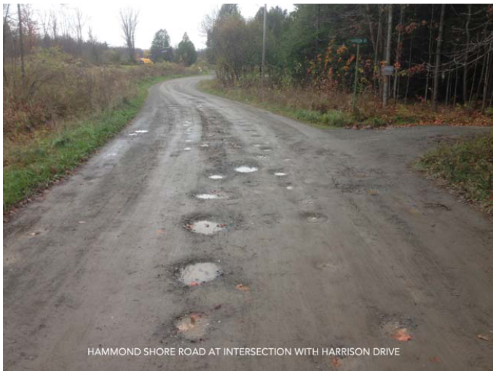
Potholes
Depressions or “holes” in the surface
Possible causes:
Insufficient crown/flat road
  Poor drainage
Excessive moisture content
Improper base materials
Poorly graded aggregates
Notes:
[Source: KAS Consulting, 2013 Private Roads Assessment and Recommendations, Lake Carmi Area, Franklin, Vermont]
Flat roads and then water ponding…
Potholes are typically caused by road sections on poorly drained soils and/or insufficient crown or road tilting. This can be rectified by rebuilding the road with proper materials or re-grading the road to remove the potholes and then re-crowning the surface.
INFO from VT Better Backroads Manual

Slide 15
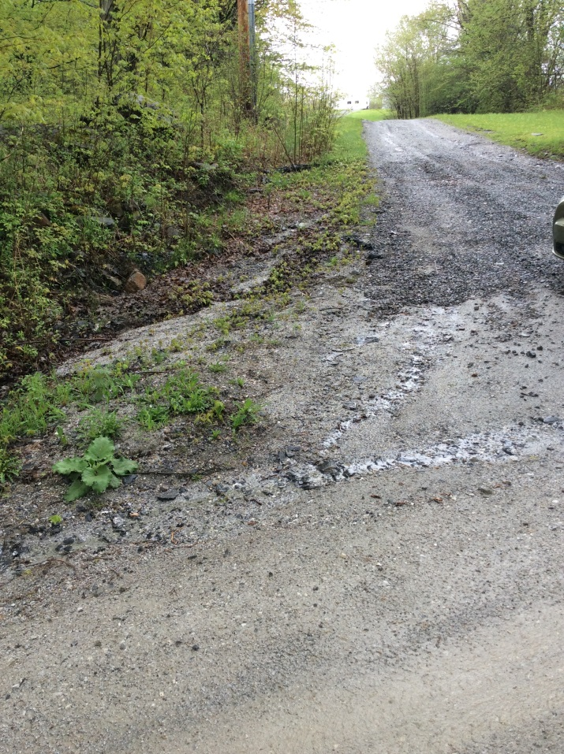
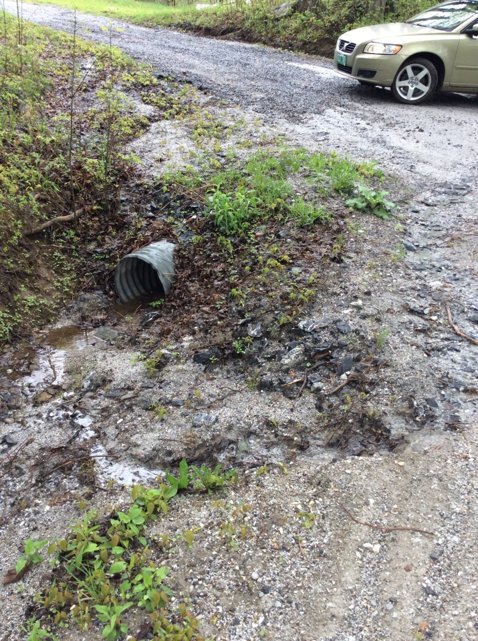
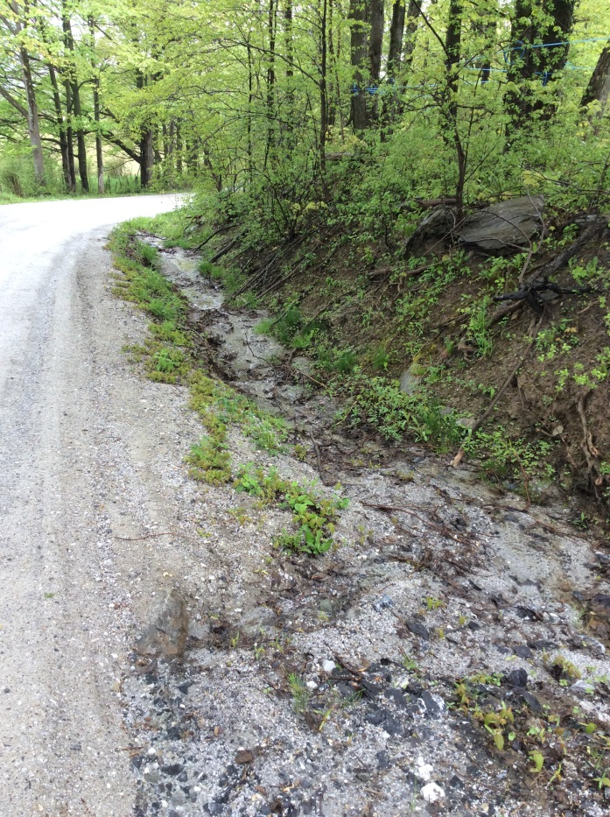

Slide 16
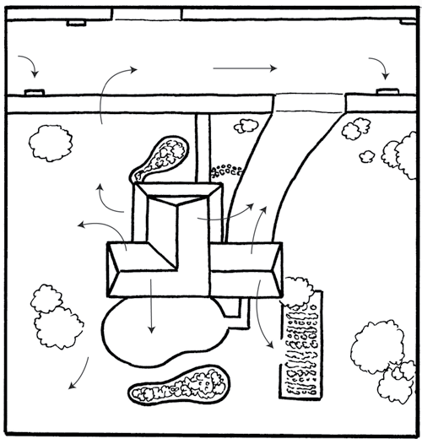
Where is the water coming from?
Need to identify the origin or cause of a particular problem
Carefully evaluate conditions specific to your road
Are there areas of your driveway you refill every year?
See Workbook for mapping flow on property

Slide 17
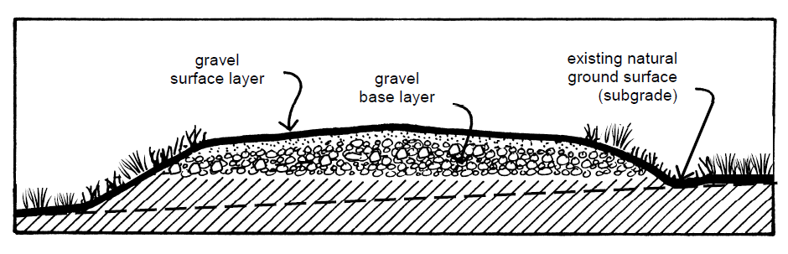
Layers of a Driveway
Base layer- Provides strength and is free draining
Surface layer- Strong and dense, sheds rainfall and prevents it from infiltrating into the bed
Notes:
[Sources: VT Local Roads Factsheet – Basics of a Good Road 2009]
A road may wear from the top, but it falls apart from the bottom.
Before doing anything to correct a road surface problem, road managers take into consideration what is causing the problem underneath. Improper drainage, insufficient depth of base or poor quality gravel may be the culprits. These should be corrected before spending money on the surface.
{Other: A road material is stable if it has little or no change in its volume and does not deform under repeated loads whether the material is wet or dry.}

Slide 18
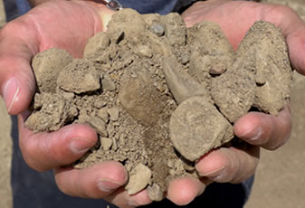
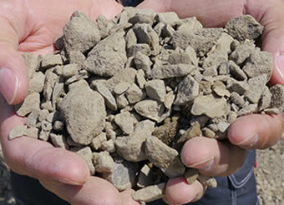


Material - Gravel Driveway
Well-graded material has a range of different size gravel and sand so that the particles “lock” together.
  If similar is size they move around and can cause rutting
Crushed gravel (has edges and packs well) vs bank run (rounded) materials
Ask for information on the percent fines and the sizes of materials.
www.redwingsandandgravel.com
Notes:
[Sources: VT Local Roads Factsheet – Basics of a Good Road 2009; Maine guide book provides specifics on page 22]
See if a VT source for this..
The type of material you use will influence how well it can be compacted. Well-graded soils having a fairly even distribution of particle sizes will compact more easily than poorly-graded soils having mostly one particle size. Jagged or semi-jagged particles will compact to a more stable configuration than rounded particles of similar size.
(Compaction is achieved by pressing soil particles together using rollers, tampers, or vibrators, expelling the air from the mass, filling the spaces between the particles, and making the material more dense.)

Slide 19
Driveway Maintenance
Maintain drainage:
  Keep water off of the road surface
    Grading to retain shape (crown or angle); Ideally, the grade should be at 2%-5%.
    Sheet flow water to vegetation or a formal practice
    Remove ridges that form along outer edge from driving or winter plowing
  Prevent groundwater from infiltrating road base
  Monitor & clean out formal practices as needed
    Remove sediment and debris
    Repair erosion spots
Notes:
Sheet flow definition - (spread out with shallow-depth, slow-velocity flow)

Slide 20
Gravel Driveway Maintenance
Directly correlated to:
quality of the installation
amount of slopes and curves
amount of moisture and water runoff
Grading – Annual shaping
Debris Removal – Remove leaves, sticks, or other debris from the gravel Regularly rake debris out
Filling in Holes/Ruts –Fill in holes with new gravel
Adding Fresh Gravel – Apply a fresh layer of gravel to the surface at least every 1-3 years

Slide 21
Ditch/Culvert Maintenance
Seasonally
Remove accumulated sediment, leaves, and debris
  at the inlet, at the outlet, and within the culvert
  Does your Municipality maintain? Check policy with Highway/Public Works Dept.
Repair/stabilize any erosion damage
Mow grass (ditches)

Slide 22
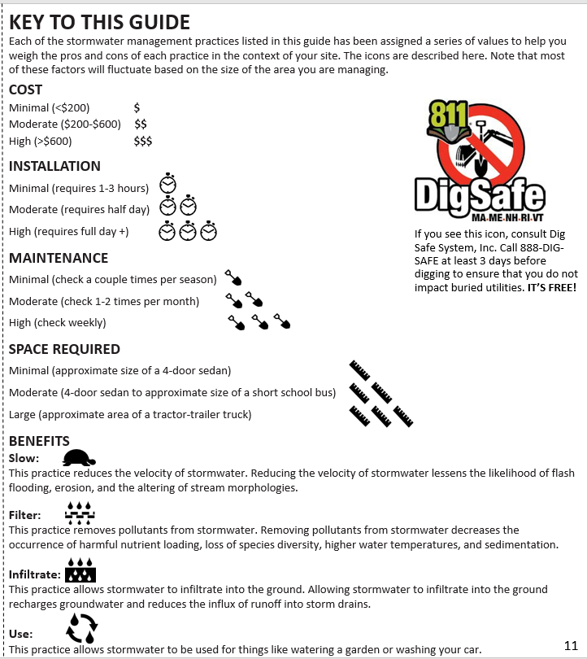
Key to this Presentation

Slide 23
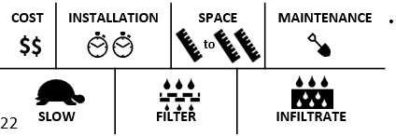
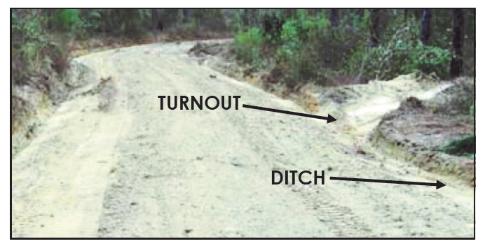
Driveway Turnouts
A driveway turnout is a simple practice where the driveway ditch is directed away from the driveway and into a relatively flat, stable area (vegetated or stone armored).

Slide 24
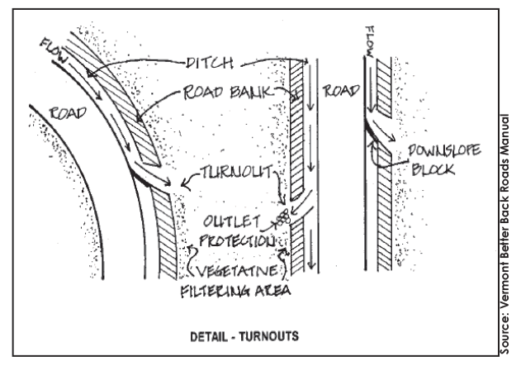
Driveway Turnouts - Installation
KEY CONCEPTS
Direct turnout to a flat, stable area – ~every 50’
High volume runoff turnouts should be stabilized
Can be used to convey runoff to another practice
Outlet should not be on a steep slope
BENEFITS
Breaks up long ditch runs that can accumulate high volumes of runoff (and cause erosion)
INSTALLATION
Relatively simple – can be done by homeowner with hand tools (or contractor with small machinery)

Slide 25
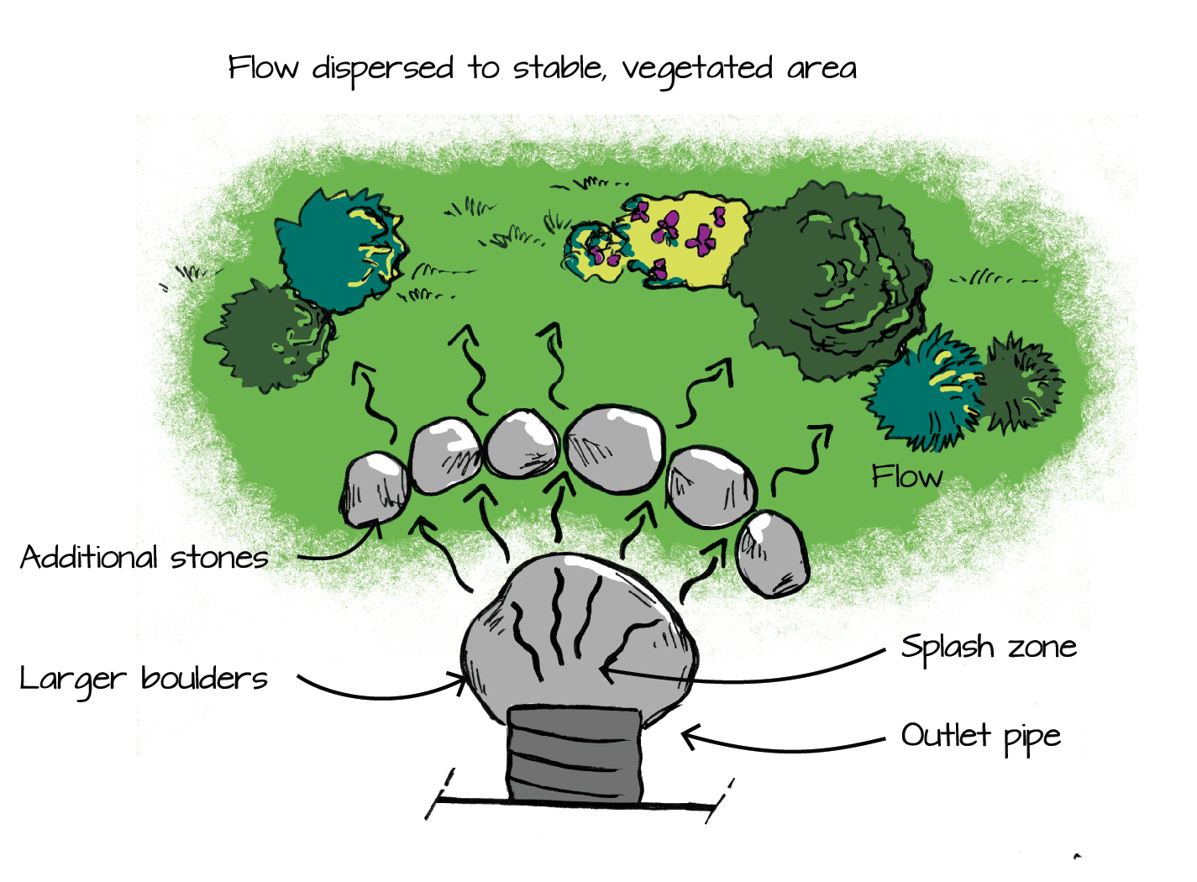
Driveway Turnouts – Flow Diffusion
KEY CONCEPT
Splash area to reduce the force of the water
Installation at the outlet of a Turnout can eliminate erosion
INSTALLATION
Relatively simple – can be done by homeowner with hand tools (or contractor with small machinery)

Slide 26
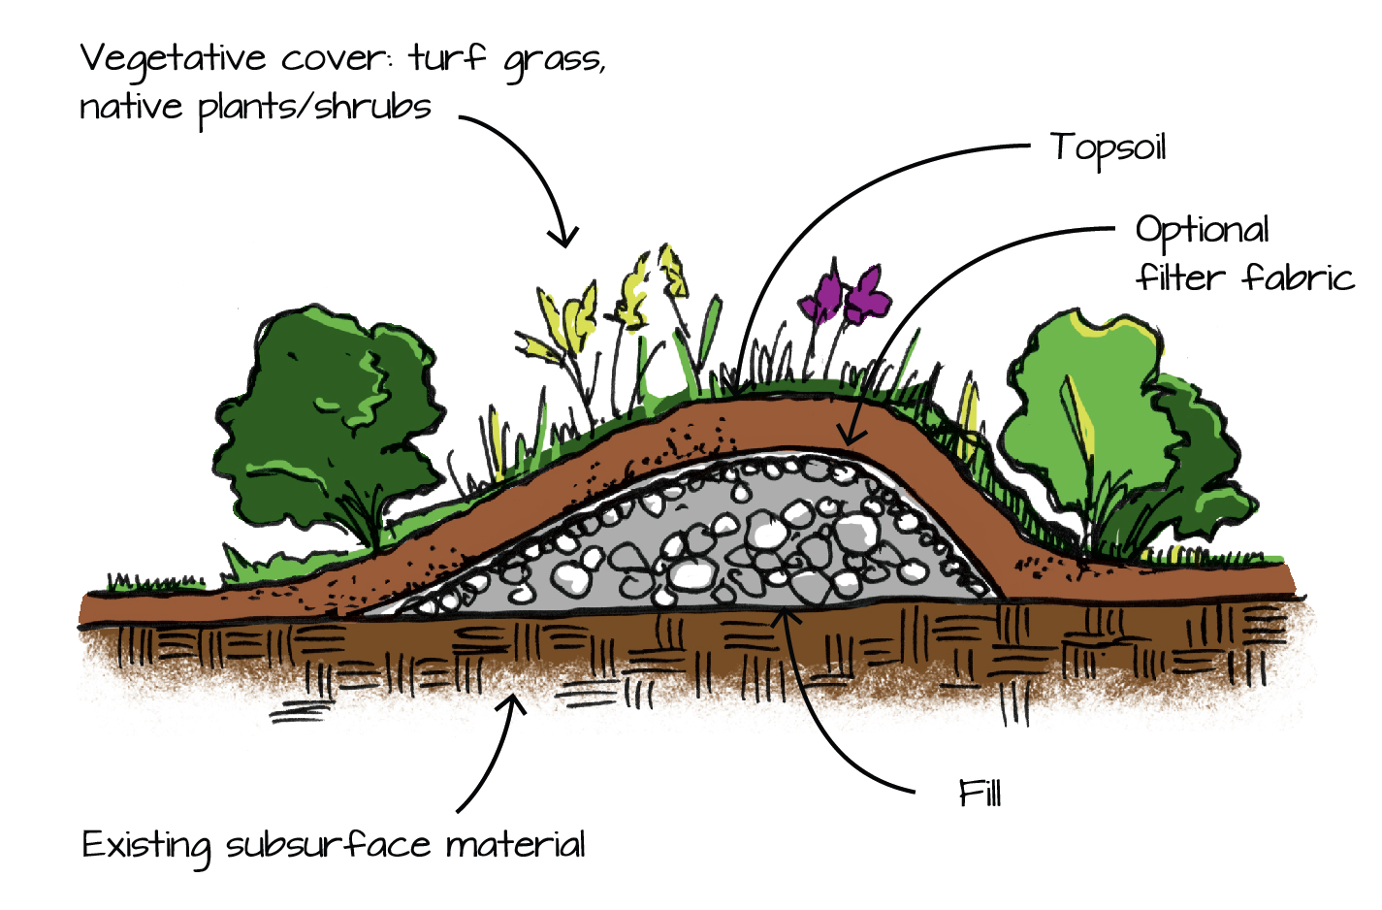
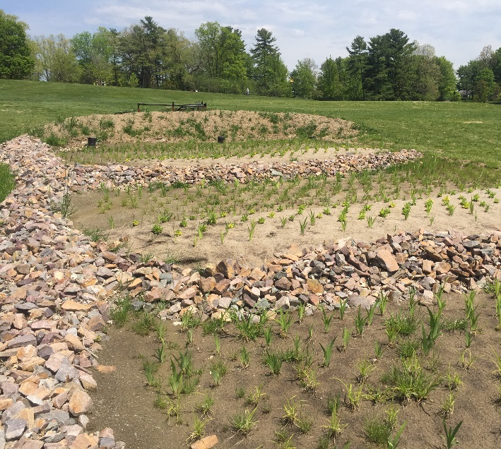
Driveway Turnouts – Filter Berm
KEY CONCEPT
Captures runoff from a turnout and holds it, allowing it to infiltration into native soil.
INSTALLATION
Relatively simple – can be done by homeowner with hand tools (or contractor with small machinery)

Slide 27
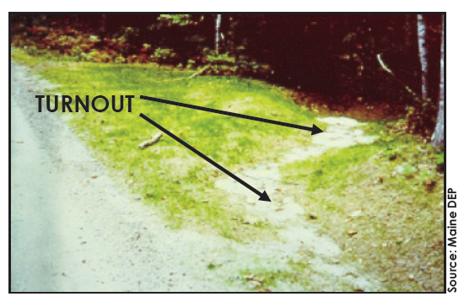
Driveway Turnouts - Considerations
MAINTENANCE
Periodically inspect turnouts for sediment accumulation and/or erosion
If erosion is occurring, fill eroded area and consider armoring with stone or installing permanent erosion control fabric
Ensure that flow dispersion practices are intact
Periodically clean sediment out of stone by removing stone, screening out the fines, and replacing the stone
LIMITATIONS
Requires flat areas adjacent to roads and road ditches

Slide 28
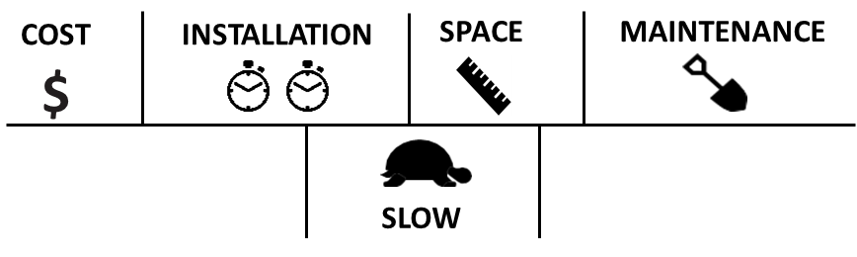


Open-top Culverts (Box Trenches)
Open-top culverts, also called box trenches or trench drains, allow surface runoff into a shallow opening that can be driven over. These opening direct runoff off the driveway surface.

Slide 29


Open-top Culvert - Installation
KEY CONCEPTS
Efficient use of space
Install across driveway gradient (angled) and outlet on to a stable area or into a stable ditch
BENEFITS
Breaks up long road runs and directs runoff off road surface, reducing erosion
Simple to install and maintain
INSTALLATION
Relatively simple – can be done by homeowner with hand tools (or contractor with small machinery)

Slide 30

Open-top Culvert - Considerations
MAINTENANCE
Periodically inspect culverts for sediment accumulation – clean out with a shovel or remove using a high-pressure hose
LIMITATIONS
Requires flat areas adjacent to roads and road ditches
Not suitable for frequently plowed roads. Consider other road runoff diversion methods or purchase a pre-fabricated trench drain suitable for plowing.

Slide 31




Driveway Shaping
Driveway shaping, or re-grading, refers to shaping the surface of the driveway such that water drains evenly off it. This can be crowning or super-elevating the driveway surface.

Slide 32


Driveway Shaping - Installation
KEY CONCEPT
Conveyance practice
Check road crown (see below)
Angular stone with fines vs smooth
INSTRUCTIONS TO CHECK CROWN
Measure your driveway. Mark the centerline.
Multiply each foot from the centerline by 0.5” to obtain a proper crown (typically a 10’ drive will have a 2.5” crown).
Check your crown using a tape measure at the edge of the drive and piece of string.
BENEFITS
Reduces runoff accumulation
Makes your driveway more useable in wet periods

Slide 33

Driveway Shaping - Considerations
MAINTENANCE
Re-grading in the spring and fall will help your driveway maintain its shape longer. This can be done with a large contractor’s rake or a tow-behind attachment for a tractor.
If problem spots crop up (small erosion areas) fill them in with good gravel and compact them to minimize their effects.
LIMITATIONS
May require more than just hand tools to accomplish – probably a contractor job!
Requires frequent attention
Can be expensive (trucking costs for gravel, labor costs if hiring out)

Slide 34



Water Bars or Rolling Grade Reversals
A water bar (sometimes called a rolling grade reversal or a broad-based dip) is like a speed bump installed across a driveway to capture surface flow and direct it off the driveway surface.

Slide 35

Water Bars - Installation
KEY CONCEPTS
Similar to open top culverts – must angle across driveway slope
Make sure they are broad and shallow – too steep will make driving over them hard!
BENEFITS
Slows and filters runoff
Reduces erosion
Directs runoff to other practices
INSTALLATION
These are best installed by a contractor – getting them right involves moving large amounts of material.

Slide 36

Water Bars – Alternative Design 1

Slide 37


Water Bars – Alternative Design 2

Slide 38

Water Bars - Considerations
MAINTENANCE
Periodically clean out accumulated debris.
Watch for erosion at the outlet of water bar.
Compact trough/peak when necessary.
LIMITATIONS
Can be difficult to install if driveway is steep
Bars must be in well marked areas so plows can take care around them
May cause lower-slung cars to bottom out. Consider filling with stone to prevent this.

Slide 39

Driveway Surfacing
MATERIALS
Crusher Run Gravel
Stay-Mat / Sure-Pak / ‘Plant Mix’
BENEFITS
Packs better than regular ‘dirt’
LIMITATIONS
More expensive

Slide 40


Culverts – General Practices
KEY CONCEPTS
Recommend minimum 15” (12” is OK) – smaller will likely clog
Make sure to cover them adequately – 12” minimum!
Install a flow diffuser at the culvert outlet to prevent erosion
MAINTENANCE
Clean out inlet/outlet frequently – clogging can lead to driveway washouts (expensive repair)

Slide 41

Ditches
TOPICS
Check Dams
Re-grading Ditches
Stone Armoring (rip-rap)
Grass Swales

Slide 42


Ditches – Check Dams
KEY CONCEPTS
Prevent erosion
Slow flow
Simple to install
Easy to maintain
Cheap!

Slide 43

Ditches – Re-grading Ditches
CONSIDERATIONS
Stone armoring is NOT always necessary – only above ~5% slopes
Gentle side slopes are crucial

Slide 44

Ditches – Grass Swales
CONSIDERATIONS
Stone armoring is NOT always necessary – only above ~5% slopes
Gentle side slopes are crucial

Slide 45
Resource Guide
Franklin County Stormwater Collaborative http://www.fcsvt.org
Resource for stormwater educational materials and events (trainings or clean-up days).
We will be posting this workshop’s resources and expanding the content of the website so check back!

Slide 46
Resource Guide
VT Better Roads Manual (2019)
Gravel Road Maintenance Manual: A Guide for Landowners on Camp and Other Gravel Roads (Maine DEP, 2016)
VT Guide to Stormwater Management for Homeowners & Small Businesses (2018)
​VT Lake Wise Program factsheets:
  2021 Lakewise Bioengineering Manual (coming soon!)
  Summary of Best Management Practices
  Crowned Driveways, Good Gravel, & Rock or Grass Lined Drainage Ditches
  Infiltration Trenches
  Open-top Culverts and Rock Aprons
  Turnouts
​2018 VLCT Drainage Management Standards for Town Highway Access Policies
​“What’s with all the Rock in the Ditch?” A Landowner’s Quick Guide to the Municipal Roads General Permit (MRGP)

Slide 47
Thank You!
Northwest Regional Planning Commission
Linda Blasch
lblasch@nrpcvt.com (802) 524-5958 EXT. 21
Watershed Consulting
Andres Torizzo
andres@watershedca.com (802) 497-2367

